Slide 1
Systems Analysis And Design
Chapter Three: Systems Analysis

Slide 2
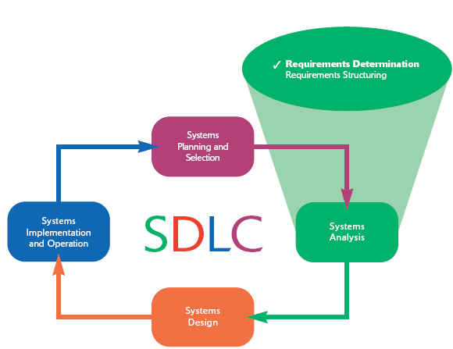

Slide 3
Determining Requirements
During requirements determination, information on what the system should do is gathered from as many sources as possible.
Gathering system requirements is like conducting an investigation and therefore requires careful scrutiny.

Slide 4
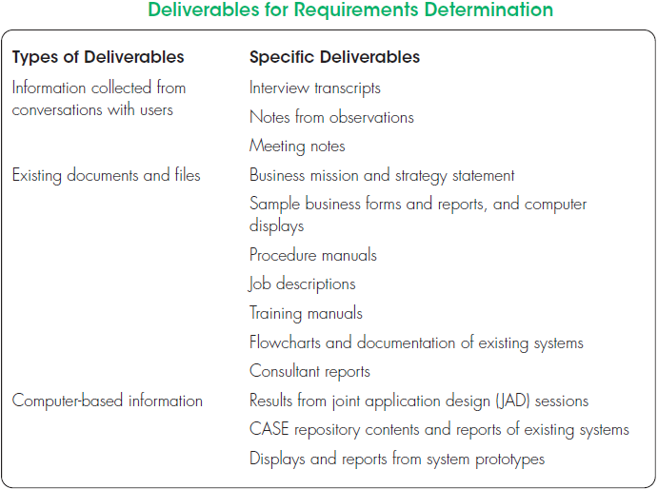

Slide 5
Understanding of the following components of an organization is crucial:
The business objectives that drive what and how work is done
The information people need to do their jobs
The data handled within the organization to support the jobs
When, how, and by whom or what the data are moved, transformed, and stored
The sequence and other dependencies among different data-handling activities
The rules governing how data are handled and processed
Policies and guidelines that describe the nature of the business, the market, and the environment in which it operates
Key events affecting data values and when these events occur

Slide 6
Traditional Methods for Determining Requirements
Collection of information is at the core of systems analysis
One of the best ways to get this information is to talk to those directly or indirectly involved in the different parts of the organization
Another way is to gather copies of documentation relevant to current systems and business processes

Slide 7
Interviewing
Interviewing is one of the primary ways analysts gather information about an information systems project.
During interviewing, you gather facts, opinions, and speculation and observe body language, emotions, and other signs of what people want and how they assess current systems

Slide 8
Guidelines for Effective Interviewing
Plan the interview
Be neutral
Listen and take notes
Review notes
Seek diverse views

Slide 9
Choosing Interview Questions: it is important to decide on the mix and sequence of open-ended and closed-ended questions to use.
Open-ended questions: Questions in interviews and on questionnaires that have no prespecified answers.
Closed-ended questions: Questions in interviews and on questionnaires that ask those responding to choose from among a set of specified responses.

Slide 10
Administering Questionnaires
More cost-effective than interviews
Choosing respondents
Should be representative of all users
Types of samples
Convenient
Random sample
Purposeful sample
Stratified sample

Slide 11
Questionnaires
Design
Mostly closed-ended questions
Can be administered over the phone, on the web, or in person
Vs. Interviews
Interviews cost more but yield more information
Questionnaires are more cost-effective

Slide 12
Observation
Observation is a fact finding technique in which the systems analyst either participates in or watches a person (user or manager) perform activities to learn about the system.
Observation information substantiates those information that are obtained from interview and questionnaire
Though observation and obtaining objective measures are desirable ways to collect pertinent information, such methods are not always possible in real organizational settings

Slide 13
Example
Observation can cause people to change their normal operating behavior
Employees who know they are being observed may be nervous and make more mistakes than normal
Employees under observation may follow exact procedures more carefully than they typically do
Because observation typically cannot be continuous, you receive only a snapshot image of the person or task you observe which may not include important events

Slide 14
Document Analysis
Methods for determining system requirements can be enhanced by examining system and organizational documentation to discover more details about current systems and the organization they support
Among the useful documents for systems analysis are:
A written work procedure
A business form
Report generated by current system
A document about current information systems

Slide 15
In documents you can find information about:
Problems with existing systems
Opportunities to meet new needs if only certain information or information processing were available
Titles and names of key individuals who have an interest in relevant existing systems
Special information-processing circumstances that occur irregularly that may not be identified by any other requirements determination technique
The reason why current systems are designed as they are, which can suggest features left out of current software that may now be feasible and desirable
Data, rules for processing data, and principles by which the organization operates that must be enforced by the information system

Slide 16
Modern Methods for Determining System Requirements
In addition to the traditional methods, today more techniques are available to collect information about the current system, the organizational area requesting the new system, and what the new system should be like
Modern methods like Joint Application Design (JAD) and Prototyping can support effective information collection and structuring while reducing the amount of time required for analysis

Slide 17
Joint Application Design
The primary purpose of using JAD in the analysis phase is to collect systems requirements simultaneously from the key people involved with the system
JAD sessions are usually conducted in a location away from where the people involved normally work, in order to limit distractions and help participants better concentrate on systems analysis.

Slide 18
A typical JAD participants include:
JAD session leader:
Users
Managers
Sponsors
Systems analysts
Scribe
IS staff
The end result of a completed JAD is a set of documents that detail the workings of the current system and the features of the replacement system

Slide 19
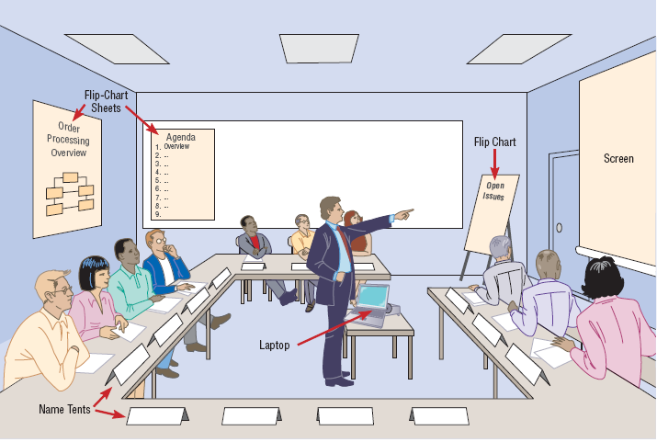

Slide 20
Using Prototyping during Requirements Determination
Prototyping is basically a repetitive process in which analysts and users build a rudimentary version of an information system based on user feedback
It can replace the systems development life cycle or augment it
Prototyping allows you to quickly convert basic requirements into a working, though limited, version of the desired information system
The goal with using prototyping to support requirements determination is to develop concrete specifications for the ultimate system, not to build the ultimate system

Slide 21
Prototyping is most useful for requirements determination when:
User requirements are not clear or well understood, which is often the case for totally new systems.
One or a few users and other stakeholders are involved with the system.
Possible designs are complex and require concrete form to evaluate fully.
Communication problems have existed in the past between users and analysts, and both parties want to be sure that system requirements are as specific as possible.

Slide 22
Prototyping also has some drawbacks as a tool for requirements determination. They include:
A tendency to avoid creating formal documentation of system requirements, which can then make the system more difficult to develop into a fully working system.
Prototypes can become idiosyncratic to the initial user and difficult to diffuse or adapt to other potential users.
Prototypes are often built as stand-alone systems, thus ignoring issues of sharing data and interactions with other existing systems.

Slide 23
System requirement specification
Systems requirement specification (SRS) is a document that contains such things as functional and non-functional requirement
SRS is the most referenced document through out the system development process.
Functional requirements: refer to major functionalities of the system that it should possess.
Non-Functional requirements : refer to additional features of the system

Slide 24
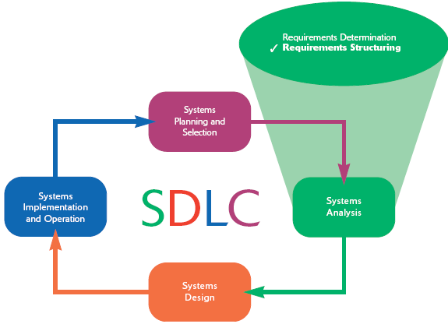

Slide 25
Process Modeling
Process modeling involves graphically representing the processes, or actions, that capture, manipulate, store, and distribute data between a system and its environment and among components within a system.
A common form of a process model is a data-flow diagram (DFD)

Slide 26
Data-Flow Diagramming Mechanics
Data-flow diagrams are versatile diagramming tools.
With only four symbols, data-flow diagrams can represent both physical and logical information systems.
The four symbols used in DFDs represent data flows, data stores, processes, and sources/sinks (or external entities)

Slide 27
A data flow:
is data that are in motion and moving as a unit from one place in a system to another
A data flow could represent:
data on a customer order form or a payroll check
a query to a database
the contents of a printed report
data on a data-entry computer display form
A data flow can be composed of many individual pieces of data that are generated at the same time and that flow together to common destinations

Slide 28
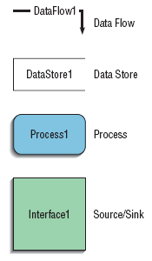
A data store:
is data at rest
may represent one of many different physical locations for data, including a file folder, one or more computer-based file(s), or a notebook
might contain data about customers, students, customer orders, or supplier invoices
A process:
is the work or actions performed on data so that they are transformed, stored, or distributed

Slide 29
A source/sink:
is the origin and/or destination of the data
are sometimes referred to as external entities because they are outside the system
Because sources and sinks are outside the system, many of their characteristics are of no interest to us
A source/sink might consist of the following:
Another organization or organizational unit that sends data to or receives information from the system you are analyzing
A person inside or outside the business unit supported by the system you are analyzing and who interacts with the system
Another information system with which the system you are analyzing exchanges information

Slide 30
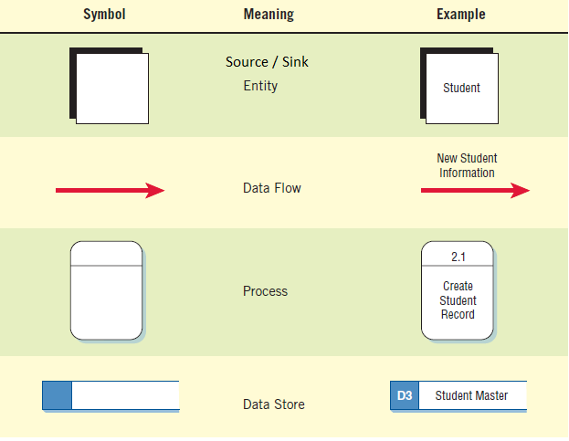
The four symbols with their meaning and example

Slide 31
Developing DFDs: An Example
Context diagram:
is a data-flow diagram of the scope of an organizational system that shows the system boundaries, external entities that interact with the system, and the major information flows between the entities and the system.
It is the most general one and the broadest possible conceptualization of the system
The process in the context diagram is given the value 0.
It shows all the Sources/sinks and the corresponding data flows but no data store is shown.

Slide 32
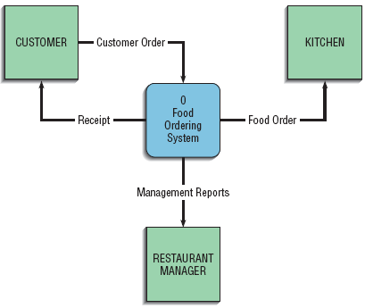
Context diagram: Example

Slide 33
Level-0 diagram
Level-0 diagram is a data-flow diagram that represents a system’s major processes, data flows, and data stores at a high level of detail.
Each process has a number that ends in .0

Slide 34
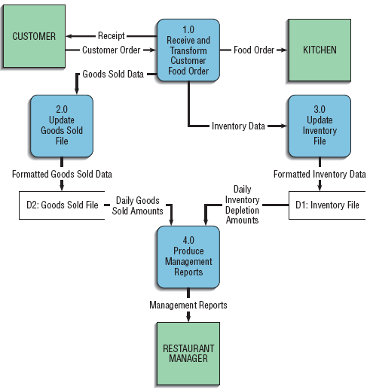
Level-0 diagram

Slide 35
Data-Flow Diagramming Rules
Process
No process can have only outputs. It is making data from nothing (a miracle). If an object has only outputs, then it must be a source
No process can have only inputs (a black hole). If an object has only inputs, then it must be a sink.
A process has a verb-phrase label.

Slide 36
Data Store
Data cannot move directly from one data store to another data store. Data must be moved by a process.
Data cannot move directly from an outside source to a data store. Data must be moved by a process that receives data from the source and places the data into the data store
Data cannot move directly to an outside sink from a data store. Data must be moved by a process.
A data store has a noun-phrase label.

Slide 37
Source/Sink
Data cannot move directly from a source to a sink. They must be moved by a process if the data are of any concern to our system. Otherwise, the data flow is not shown on the DFD.
A source/sink has a noun-phrase label.

Slide 38
Data Flow
A data flow has only one direction of flow between symbols. It may flow in both directions between a process and a data store to show a read before an update. The latter is usually indicated, however, by two separate arrows because the read and update usually happen at different times.
A fork in a data flow means that exactly the same data go from a common location to two or more different processes, data stores, or sources/sinks (it usually indicates different copies of the same data going to different locations).
A join in a data flow means that exactly the same data come from any of two or more different processes, data stores, or sources/sinks to a common location.

Slide 39
Data Flow (cont’d)
A data flow cannot go directly back to the same process it leaves. At least one other process must handle the data flow, produce some other data flow, and return the original data flow to the beginning process.
A data flow to a data store means update (delete or change).
A data flow from a data store means retrieve or use.
A data flow has a noun-phrase label. More than one dataflow noun phrase can appear on a single arrow as long as all of the flows on the same arrow move together as one package.

Slide 40
Decomposition of DFDs
The act of going from a single system to its component processes is called (functional) decomposition
Functional decomposition is a repetitive process of breaking the description or perspective of a system down into finer and finer detail
Decomposition continues until no sub-process can logically be broken down any further
The lowest level of DFDs is called a primitive DFD

Slide 41
Example 1: Decomposing a level-0 DFD
This example shows us decomposing the process called “Receive and Transform Customer Food Order” into:
Receive a customer order
transform the entered order into a printed receipt for the customer
transform the order into a form meaningful for the kitchen’s system
transform the order into goods sold data, and
transform the order into inventory data

Slide 42

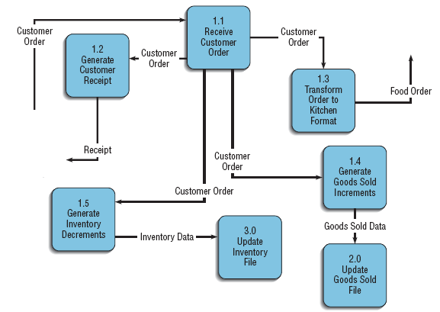

Slide 43
Note in the previous slide that:
each of the five processes are labeled as sub-processes of Process 1.0: Process 1.1, Process 1.2, and so on
each of the processes and data flows are named
No sources or sinks are represented
This type of data-flow diagram is called a level-1 diagram
In general, a level-n diagram is a DFD that is generated from n nested decompositions from a level-0 diagram.

Slide 44
Example 2: Decomposing a level-0 DFD
This example shows us decomposing the process called “Produce Management Reports” into:
Access Goods Sold and Inventory Data
Aggregate Goods Sold and Inventory Data
Prepare Management Reports

Slide 45

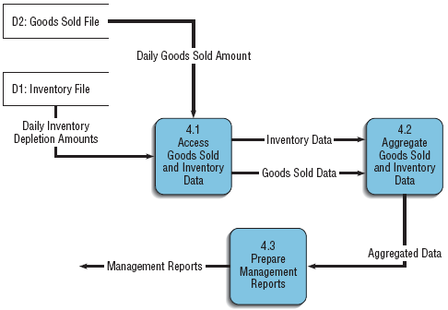

Slide 46

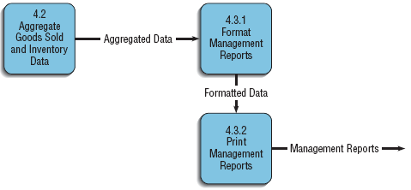
Creating a level-2 diagram

Slide 47
Balancing DFDs
Balancing refers to the conservation of inputs and outputs to a data-flow diagram process when that process is decomposed to a lower level.
For example, Process 1.0, which appears in a level-0 diagram, must have the same inputs and outputs when decomposed into a level-1 diagram

Slide 48
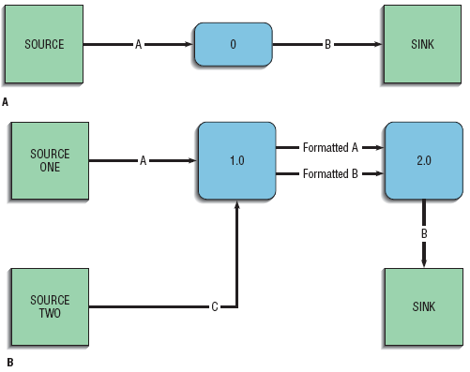
Example: An unbalanced set of data flow diagrams

Slide 49
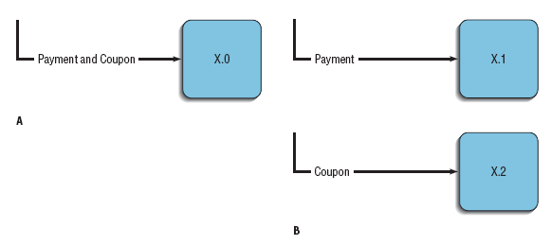
A data flow consisting of several sub-flows on a level-n diagram can be split apart on a level-n+1 diagram for a process that accepts this composite data flow as input

Slide 50
Guidelines for Drawing DFDs
An understanding of how to correctly use a DFD is important because data-flow diagrams are essential tools for the structured analysis process.
The guidelines for effective structuring of the analysis process include:
Completeness
Consistency
Timing considerations
The iterative nature of drawing DFD
Drawing primitive DFD

Slide 51
DFD completeness: refers to the extent to which all necessary components of the system have been included and fully described in the model.
DFD consistency: refers to the extent to which information contained on one level of a set of nested data-flow diagrams is also included on other levels.

Slide 52
DFD Timing: refers to drawing the DFD as if the system you are modeling has never started and will never stop
DFD Iterative Development: refers to counting on drawing the same diagram over and over again, in an iterative fashion. Iterative DFD development recognizes that requirements determination and requirements structuring are interacting, not sequential, sub-phases of the analysis phase of the SDLC.

Slide 53
Primitive DFDs: One of the more difficult decisions you need to make when drawing DFDs is when to stop decomposing processes.
One rule is to stop drawing when you have reached the lowest logical level; however, it is not always easy to know what the lowest logical level is

Slide 54
Logic Modeling
Although data-flow diagrams are good for identifying processes, they do not show the logic inside the processes
Because data-flow diagrams are not really designed to show the detailed logic of processes, you must model process logic using other techniques
Logic modeling involves representing the internal structure and functionality of the processes represented on data-flow diagrams

Slide 55
Modeling Logic with Decision Tables
Decision table is a matrix representation of the logic of a decision, which specifies the possible conditions for the decision and the resulting actions.
A decision table has three parts:
Condition stubs is part of a decision table that lists the conditions relevant to the decision.
Action stubs is part of a decision table that lists the actions that result for a given set of conditions.
Rules is part of a decision table that specifies which actions are to be followed for a given set of conditions.

Slide 56
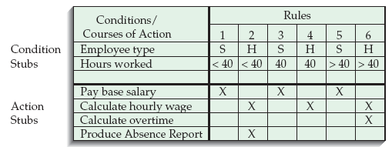
Example

Slide 57
Indifferent condition: is a condition whose value does not affect which actions are taken for two or more rules.
The number of hours worked does not affect the outcome for rules 1, 3, or 5 in the example of the previous slide. For these rules, hours worked is an indifferent condition, in that its value does not affect the action taken
Such conditions can be used to reduce the number of rules and thereby simplifying the table as shown in the next slide

Slide 58
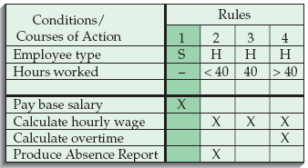

Slide 59
Decision Table Basic Procedures
In constructing decision tables, the general set of basic procedures to be followed are:
Name the conditions and the values each condition can assume.
Name all possible actions that can occur.
List all possible rules.
Define the actions for each rule.
Simplify the decision table.

Slide 60
Modeling Logic with Decision Trees
A graphical representation of a decision situation
Decision situation points are connected together by arcs and terminate in ovals
Two main components
Decision points represented by nodes
Actions represented by ovals

Slide 61
Read from left to right
Each node corresponds to a numbered choice on a legend
All possible actions are listed on the far right

Slide 62
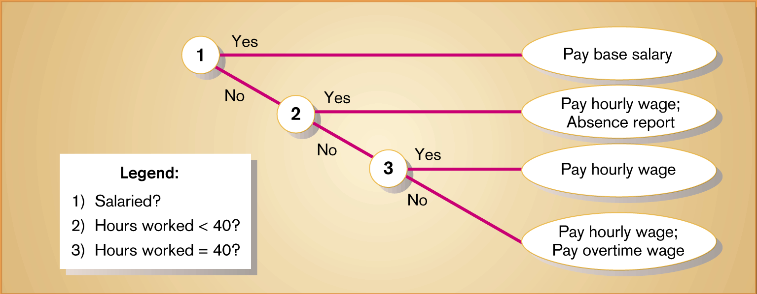
Example

Slide 63
Modeling Logic with Structured English
Structured English is a modified form of the English language used to specify the logic of information system processes.
Although there is no single standard, structured English typically relies on action verbs and noun phrases and contains no adjectives or adverbs.
It is possible to use Structured English to represent all three processes typical of structured programming: sequence, conditional statements, and repetition.

Slide 64
Conditional statement
BEGIN IF
IF Quantity-in-stock is less than Minimum-order-quantity
THEN GENERATE new order
ELSE DO nothing
END IF
Repetition
DO
BEGIN IF
IF Quantity-in-stock is less than Minimum-order-quantity
THEN GENERATE new order
ELSE DO nothing
END IF
UNTIL End-of-file

Slide 65
Conceptual Data Modeling
A conceptual data model is a representation of organizational data.
The purpose of a conceptual data model is to show as many rules about the meaning and interrelationships among data as possible, independent of any database management system or other implementation considerations.
Entity-relationship (E-R) data model is a commonly used diagram that shows how data are organized in an information system.

Slide 66
The main goal of conceptual data modeling is to create accurate E-R diagrams
Methods such as interviewing, questionnaires, and JAD sessions can be used to collect information for conceptual data modeling
On larger systems development teams, a subset of the project team concentrates on data modeling while other team members focus attention on process or logic modeling

Slide 67
Since the process flow, decision logic, and data-model descriptions of a system describe different but complementary views of the same information system, they must be consistent and complete.
For example, the names of data stores on primitive-level DFDs often correspond to the names of data entities in entity-relationship diagrams, and the data elements in data flows on DFDs must be attributes of entities and relationships in entity-relationship diagrams

Slide 68
Introduction to Entity-Relationship Modeling
The basic entity-relationship modeling notation uses three main constructs:
data entities
relationships, and
Attributes
An entity-relationship diagram (or E-R diagram ) is a detailed, logical, and graphical representation of the data for an organization or business area

Slide 69
The E-R diagram is a model of entities in the business environment, the relationships or associations among those entities, and the attributes or properties of both the entities and their relationships
A rectangle is used to represent an entity, and lines are used to represent the relationship between two or more entities

Slide 70
Entities
An entity is a person, place, object, event, or concept in the user environment about which the organization wishes to maintain data
An entity has its own identity, which distinguishes it from every other entity
Some examples of entities are:
Person: EMPLOYEE, STUDENT, PATIENT
Place: CITY, REGION, COUNTRY, BRANCH
Object: MACHINE, BUILDING, AUTOMOBILE, PRODUCT
Event: SALE, REGISTRATION, RENEWAL
Concept: ACCOUNT, COURSE

Slide 71
Entity type
Entity type is a collection of entities that share common properties or characteristics.
Each entity type in an E-R model is given a name
The name is written in singular form
A simple noun is used to name an entity type
Capital letters are used in naming an entity type, and in an E-R diagram, the name is placed inside a rectangle representing the entity

Slide 72
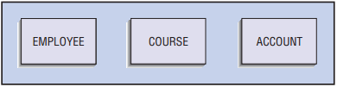
Example of Entity type:

Slide 73
Entity instance
An entity instance (or instance) is a single occurrence of an entity type
An entity type is described just once in a data model, whereas many instances of that entity type may be represented by data stored in the database
For example, most organizations have one EMPLOYEE entity type, but hundreds of instances of this entity type may be stored in the database

Slide 74
Attributes
Each entity type has a set of attributes associated with it
An attribute is a property or characteristic of an entity that is of interest to the organization
Following are some typical entity types and associated attributes:
STUDENT: Student_ID, Student_Name, Address, Phone_Number, Major
AUTOMOBILE: Vehicle_ID, Color, Weight, Horsepower
EMPLOYEE: Employee_ID, Employee_Name, Address, Skill

Slide 75
We use nouns with an initial capital letter followed by lowercase letters in naming an attribute
In E-R diagrams, we represent an attribute by placing its name inside the rectangle that represents the associated entity

Slide 76
Candidate Keys and Identifiers
Every entity type must have an attribute or set of attributes that distinguishes one instance from other instances of the same type
A candidate key is an attribute (or combination of attributes) that uniquely identifies each instance of an entity type
A candidate key for a STUDENT entity type might be Student_ID

Slide 77
Some entities may have more than one candidate key
One candidate key for EMPLOYEE is Employee_ID; a second is the combination of Employee_Name and Address (assuming that no two employees with the same name live at the same address)
An identifier is a candidate key that has been selected to be used as the unique characteristic for an entity type

Slide 78
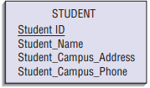
For each entity, the name of the identifier is underlined on an E-R diagram.

Slide 79
Multivalued Attributes
A multivalued attribute may take on more than one value for each entity instance
Suppose that, Skill is one of the attributes of EMPLOYEE. If each employee can have more than one Skill, then it is a multivalued attribute
During conceptual design, two common special symbols or notations are used to high-light multivalued attributes

Slide 80
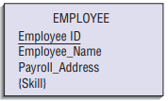
curly brackets are one type of notations used around the name of the multivalued attribute

Slide 81
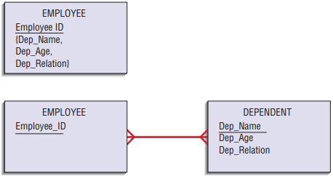
a second approach is to represent the multivalued attribute as another entity, called a weak (or attributive) entity, and then using a relationship link the weak entity to its associated regular entity
The approach also easily handles several attributes that repeat together, called a repeating group as shown in the above example.

Slide 82
Relationships
Relationships are the glue that hold together the various components of an E-R model
A relationship is an association between the instances of one or more entity types that are of interest to the organization
An association usually means that there is an event or that some natural linkage exists between entity instances
For this reason, relationships are labeled with verb phrases

Slide 83
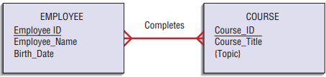
For example, a training department in a company is interested in tracking which training courses each of its employees has completed

Slide 84
Degree of a Relationship
The degree of a relationship is the number of entity types that participate in that relationship
The three most common relationships in E-R diagrams are:
unary (degree one)
binary (degree two), and
ternary (degree three)

Slide 85


Unary Relationship
Unary relationship (recursive relationship) is a relationship between the instances of one entity type.

Slide 86

Binary Relationship
A binary relationship is a relationship between instances of two entity types and is the most common type of relationship encountered in data modeling

Slide 87
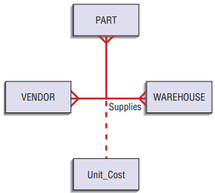
Ternary Relationship
A ternary relationship is a simultaneous relationship among instances of three entity types

Slide 88
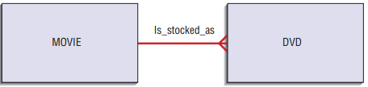
Cardinalities in Relationships
Cardinality is the number of instances of entity B that can (or must) be associated with each instance of entity A

Slide 89
Minimum and Maximum Cardinalities
The minimum cardinality of a relationship is the minimum number of instances of entity B that may be associated with each instance of entity A
When the minimum cardinality of a relationship is zero, then we say entity B is an optional participant in the relationship
When the minimum cardinality of a relationship is one, then we say entity B is a mandatory participant in the relationship

Slide 90
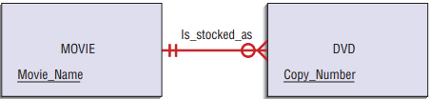
The maximum cardinality is the maximum number of instances
The zero through the line near the DVD entity means a minimum cardinality of zero, whereas the crow’s-foot notation means a “many” maximum cardinality.
It is possible for the maximum cardinality to be a fixed number, not an arbitrary “many” value

Slide 91

Associative Entities
Attributes sometimes may be associated with a many-to-many relationship
For example, suppose that an organization wishes to record the date (month and year) when an employee completes each course

Slide 92
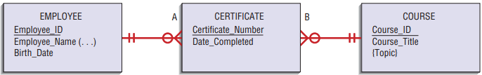
From the data of the previous slide you can conclude that the attribute Date-Completed is not a property of the entity EMPLOYEE. Nor is Date-Completed a property of COURSE, because a particular course may be completed on different dates
Instead, Date-Completed is a property of the relationship between EMPLOYEE and COURSE as depicted below

Slide 93
Selecting the Best Alternative Design Strategy
Selecting the best alternative system involves at least two basic steps:
generating a comprehensive set of alternative design strategies, and
(2) selecting the one that is most likely to result in the desired information system, given all of the organizational, economic, and technical constraints that limit what can be done

Slide 94
A system design strategy represents a particular approach to developing the system
Selecting a strategy requires you to answer questions about the system’s functionality, hardware and system software platform, and method for acquisition
After the system requirements have been structured in terms of process flow and data, analysts again work with users to package the requirements into different system configurations

Slide 95
Shaping alternative system design strategies involves the following processes:
Dividing requirements into different sets of capabilities, ranging from the bare minimum that users would accept to the most elaborate and advanced system the company could afford to develop
Enumerating different potential implementation environments that could be used to deliver the different sets of capabilities
Proposing different ways to acquire the various sets of capabilities for the different implementation environments.

Slide 96
A good number of alternatives for analysts to generate is three because three alternatives can neatly represent low, middle, and high ranges of potential solutions
Low-end alternatives are the most conservative in terms of the effort, cost, and technology involved in developing a new system
High-end alternatives go beyond simply solving the problem in question and focus instead on systems that contain many extra features users may desire
Midrange alternatives repesent compromise solutions

Slide 97
How do you know where to draw bounds around the potential solution space?
At the end of analysis, a survey can be conducted to rate different features of the system as mandatory and desired features.
Mandatory features are the ones that everyone agrees are necessary to solve the problem or meet the opportunity
Desired features are those that users could live without

Slide 98
Features can take many different forms as:
Data kept in system files: For example, multiple customer addresses so that bills can be sent to addresses different from where we ship goods.
System outputs: Printed reports, online displays, transaction documents (for example, a paycheck or sales summary graph).
Analyses to generate the information in system outputs: For example, a sales forecasting module or an installment billing routine.
Expectations on accessibility, response time, or turnaround time for system functions: For example, online, real-time updating of inventory files

Slide 99
Constraints that are used in drawing bounds around alternative strategies include:
A date when the replacement system is needed.
Available financial and human resources.
Elements of the current system that cannot change.
Legal and contractual restrictions
The importance or dynamics of the problem that may limit how the system can be acquired

Slide 100
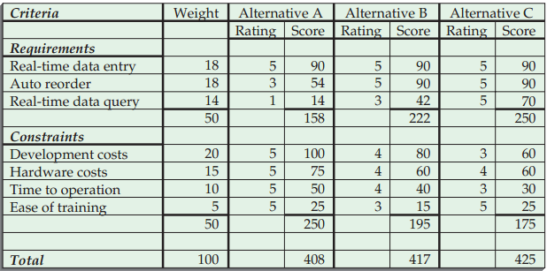

Slide 101
Issues to Consider in Generating Alternatives
Outsourcing
The practice of turning over responsibility of some to all of an organization’s information systems applications and operations to an outside firm
Can provide a cost effective solution
Sources of Software
Hardware manufacturers
Packaged software producers
Custom software producers
Enterprise solution software
Application Service Providers
In-house development

Slide 102
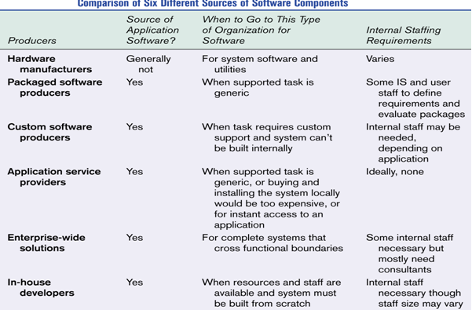

Slide 103
Criteria for Choosing Off-the-Shelf Software
Cost
In-House versus purchased
Functionality
Mandatory, essential and desired features
Vendor Support
Installation
Training
Technical Support
Viability of Vendor

Slide 104
Criteria for Choosing Off-the-Shelf Software
Flexibility
Ease of customization
Documentation
User documentation
Technical documentation
Response Time
Ease of Installation

Slide 105
Validating Purchased Software Information
Information from vendor
Request for proposal
A document provided to vendors to ask them to propose hardware and system software that will meet the requirements of your new system
Software evaluation period
Customer references from vendor
Independent software testing service
Trade publications

Slide 106
Implementation and Organizational Issues
Implementation Issues
Technical and social aspects of implementation need to be addressed
Training
Disruption of work
Organizational Issues
Overall cost and availability of funding
Management support
User acceptance

